Slide 1

D-MART-SALES-ANALYSIS PROJECT
-ANSUMAN MISHRA
-mishransuman@gmail.com

Slide 2

PROBLEM STATEMENT
Build a predictive model with 2013 sales data from 1559 products across 10 stores to forecast sales at individual outlets. The goal is to understand the impact of product and store attributes on sales, helping BigMart optimize strategies to boost sales and identify critical factors driving performance

Slide 3
STAGES OF THE PROGECT
MODEL DEVELOPMENT
Selecting algorithms, train models, fine-tune hyperparameters, and assess performance using the validation dataset for optimization.
MODEL INTERPRETATION
Measure performance with metrics, analize feature importance, and validate with unseen data to ensure real-world effectiveness.
DATA PREPARATION
Collect, clean, transform, and split data into training, validation, and test sets for accurate model evaluation.

Slide 4

DATASET
01. DIMENTIONS
The dataset contains 8523 rows and 12 columns, providing a substantial amount of data for analysis and modeling.
02. Target Variables
Item_Outlet_Sales - A continuous numerical variable representing sales amount, indicating this is a regression problem.
03. Unique Item Identifiers
Item_Identifier and Outlet_Identifier - Unique codes for items and outlets, useful for merging datasets and tracking specific records.
04. Data Scope
The range of years covered, number of unique items, and outlets, which provides insight into the dataset’s scope and diversity.

Slide 5
DATA PREPARATION
The dataset has (5681, 11) and (8523,12) rows and columns respectively. And covers various attributes such as Item_Weight, Item_Fat_Content, Item_Visibility, Item_Type, Item_MRP, Outlet_Identifier, Outlet_Establishment_Year, Outlet_Size, Outlet_Location_Type, and Outlet_Type.
Handle missing values, particularly in columns like Outlet_Size which contains NaN values. Techniques such as imputation (e.g., filling missing values with the mean) but not removing rows with missing values could be used.
Normalize or scale numerical features like Item_Weight, Item_Visibility, and Item_MRP to ensure they are on similar scales. Encode categorical variables such as Item_Fat_Content, Item_Type, Outlet_Size, and Outlet_Type using techniques like label encoding.
Divide the dataset into training and test sets.80% of the data could be used for training, 20% for testing. This separation allows for accurate model evaluation and prevents overfitting.

Slide 6
MODEL DEVELOPEMENT
In the Model Development phase,I use Linear Regression to predict `Item_Outlet_Sales` with features like `Item_Weight`, `Item_Visibility`, and `Item_MRP`, evaluating with R-squared and MAE. Apply Random Forest Regressor to capture non-linear relationships and assess performance with R-squared and feature importance. Use XGBoost Regressor (XGBRegressor) for enhanced accuracy through HYPERPARAMETER TUNNING, evaluating it similarly. Comparing these models will determine the best approach for accurate sales prediction.

Slide 7

MODEL INTERPRETATION
In the Model Evaluation and Interpretation phase, accuracy is assessed using R-squared and Mean Absolute Error (MAE).This comprehensive evaluation helps in refining the model and deriving actionable insights from the data.
R-squared:
Measures how well the model explains the variance in Item_Outlet_Sales. A higher R-squared value indicates a better fit of the model to the data.
Mean Absolute Error (MAE)
Calculates the average magnitude of prediction errors. Lower MAE values signify more accurate predictions.

Slide 8
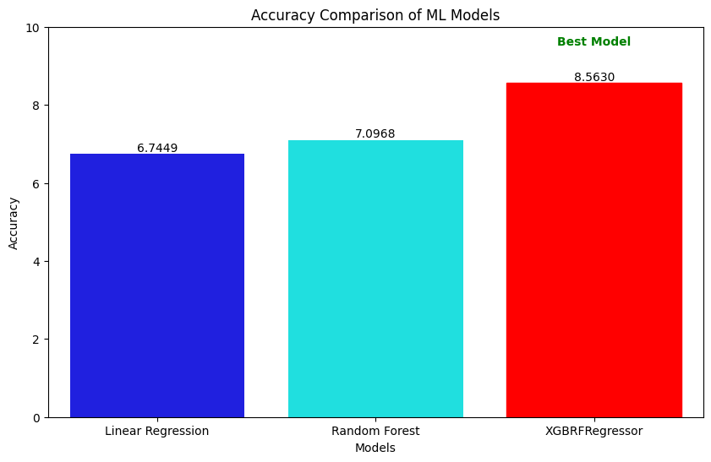
ACCURACY GRAPH
The bar chart visualizes the accuracy of three classifiers: Linear Regression, Random Forest, and XGBRFRegressor. Each bar represents a classifier’s performance, with higher bars indicating better accuracy. The chart helps compare models at a glance, making it easier to identify which classifier performs best based on accuracy scores

Slide 9
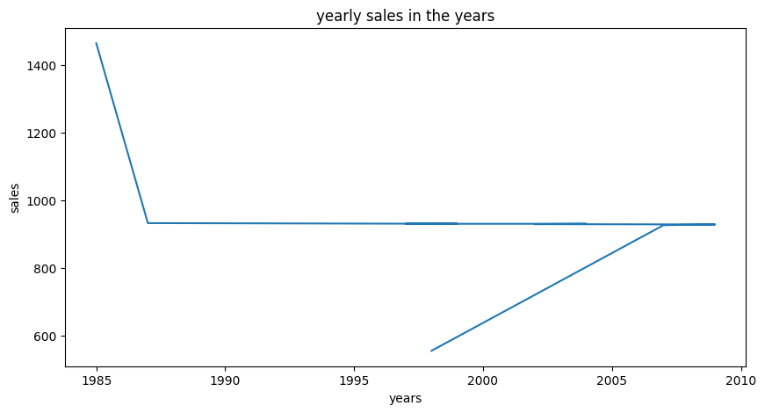
YEARLY SALES GRAPH
This graph represents the yearly sales in the year.
It bassicaly highlight the specific year when the sales are high or low

Slide 10
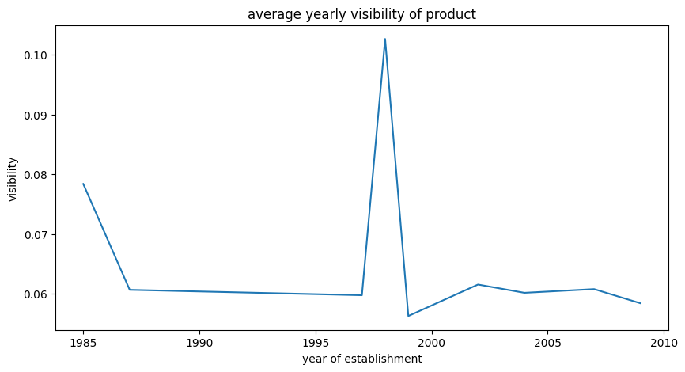
Average VISIBILITY OF THE PRODUCT
.The average sales volume for a product compared to others
a higher average visibility might translate to an average line positioned higher on the graph, indicating generally stronger sales

Slide 11

CONCLUSION
Following the normalization and standardization of both training and testing data, three machine learning models—Random Forest Regressor, Linear Regression, and XGBoost Regressor (XGBRegressor)—were rigorously evaluated. After thorough testing, XGBRegressor demonstrated the highest accuracy, showcasing its superior ability to predict Item_Outlet_Sales compared to the other models. Given its robust performance, XGBRegressor was selected for final predictions on the test dataset, which consists of previously unseen data. This final evaluation confirms the model’s effectiveness and its capacity to generalize well, ensuring reliable and actionable insights in real-world scenarios.

